Slide 1
ENSE 496ab, Milestone 1
!Cool
Team Members:
Christian John
Ahmed Shamiss
Jeremy Cross
Evan Geissler
Taylen Jones
Dakota Fisher
27th September, 2018

Slide 2
Team !Cool
We are team !Cool and and our group members are:
Christian John
Ahmed Shamiss
Jeremy Cross
Evan Geissler
Taylen Jones
Dakota Fisher
We are assigned to the Weekend Warriors project

Slide 3
Review & analysis
Comment on the readability and usability of the GitHub content for the team’s project you were assigned
Github content clear and easy to understand.
Questionnaires have been very helpful.
What do you like about the team’s design/design choices
Simplistic UI design.
Searchability
Layout
Notes:
Christian and Ahmed

Slide 4
Review & analysis
What do you dislike about the team’s design/design choices
Clutter and redundancies in some of the menus.
No activity log
Tabs feel out of place
Sorting by states/teams/names
What did the users say (if anything) that may correspond to your team’s feelings
We preferred Homepage over Dashboard which most users agreed on.

Slide 5
Revisioning
Discuss any ideas you have for extending/revisioning the design
Allow sorting of ideas by idea state, team, and/or name.
Rework left hand tabs: rename, reduce redundancy, etc.
Extend different parts of the web page i.e. reduce unused space.
Add a user signup page
Remove “Status” above an idea, but keep status bar
Remove buttons for comments and likes (redundant)
Notes:
Evan
Dakota: Added Sign Up page to USM

Slide 6
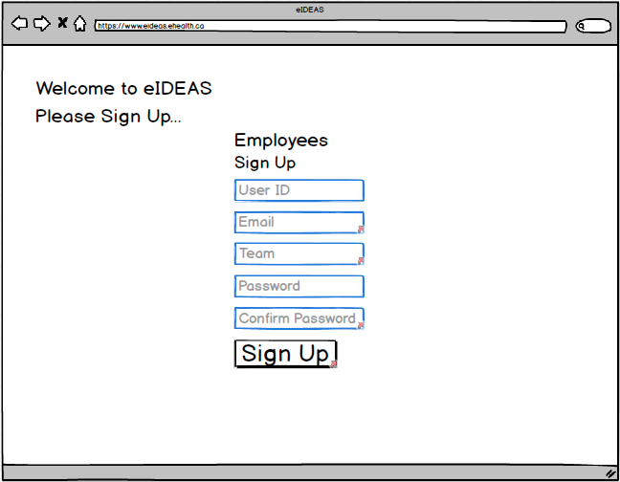
Sign Up Page

Slide 7
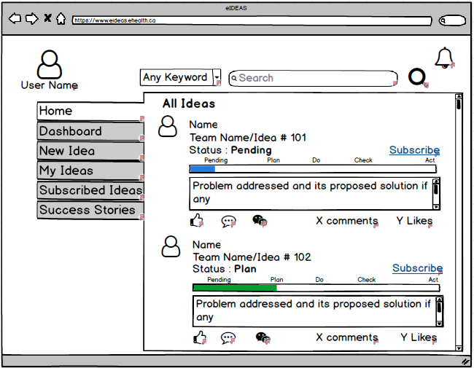
Original

Slide 8
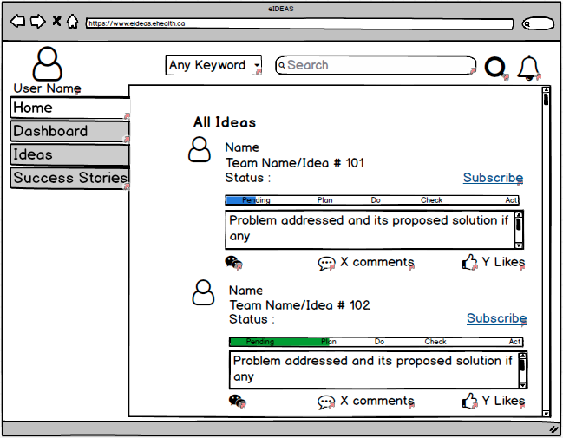
Revised

Slide 9
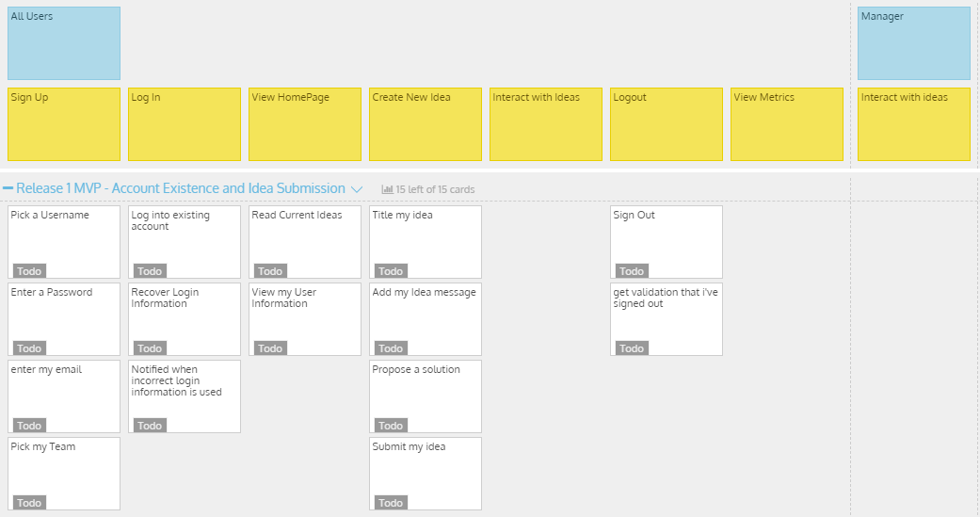
Release 1

Slide 10
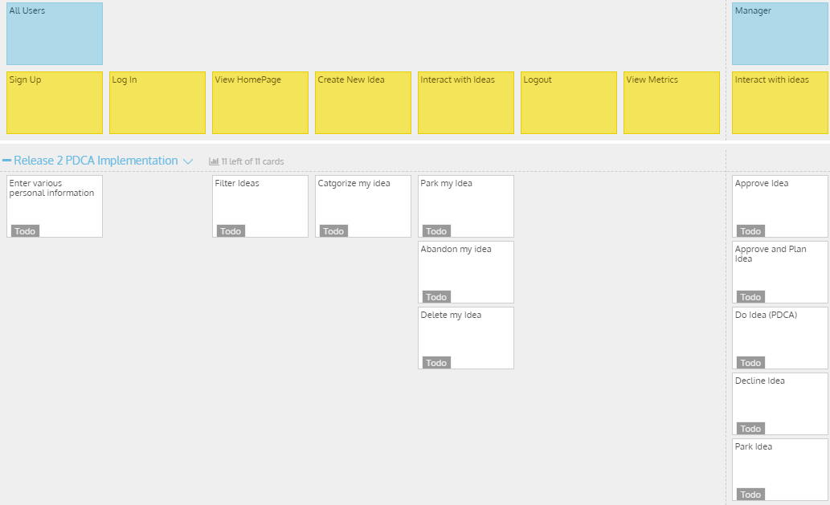
Release 2

Slide 11
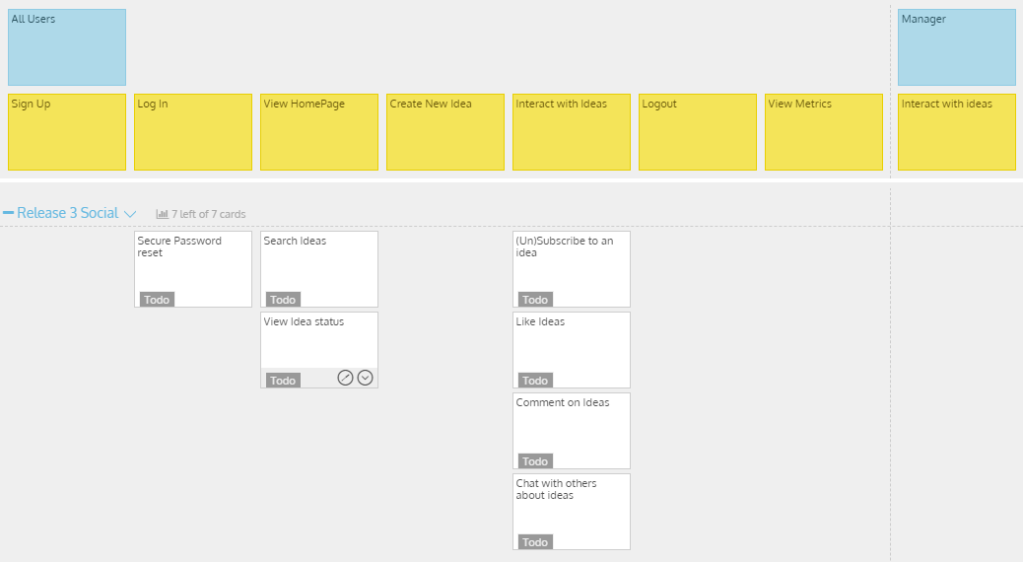
Release 3
Notes:
Dakota

Slide 12
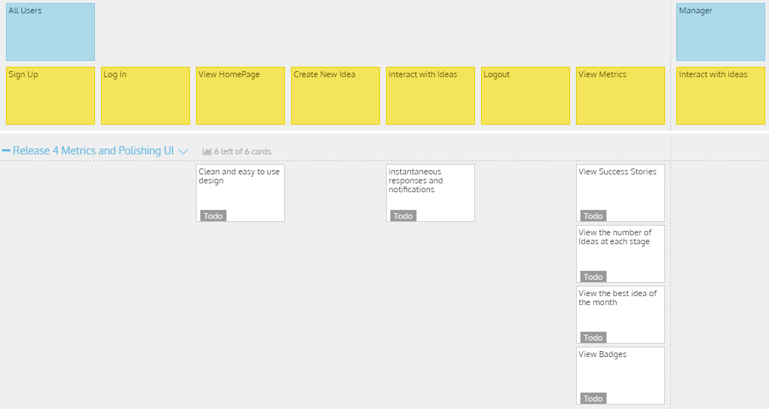
Release 4 - Miscellaneous + Final Product

Slide 13
Misc./Possibilities
Gamify via adding Badges
Videogames and forums implement this as achievements
“Novice Ideologist”: submitting 5 ideas
Various other badges for different levels of commenting, liking, etc.
Can be shown below profile photo next to ideas.
Notes:
Everyone

Slide 14
Group reflection
How did you feel about this milestone? What did you like about it? What did you dislike?
The concept of bringing another groups ideas to life is interesting
We didn’t like the possible hurdles of changing/incorporating our own ideas
What did you learn about yourself as you collaborated and worked through this milestone?
Working with other groups design ideas is tough without wanting to change almost every aspect
Notes:
Taylen

Slide 15
Group reflection
How will you use what you have learned going forward?
The collaborative nature of StoriesOnBoard will allow us to keep up to date with what needs to be completed, and manage a backlog of use features.
What “stuff & things” related to this milestone would you want help with?
Nothing in particular for this milestone.
Notes:
Taylen

